Slide 1
Fundamentals of the Analysis of Algorithms Efficiency
Group – I Presentation (Solvi Magnusson, Ishan Anand, Rishi, Tej Talluri)
Reference : Introduction to Design and Analysis of Algorithms, 3rd Edition by Anany Levitin

Slide 2
Introduction
The Technique is used to investigate the efficiency of the algorithm in terms of Running Time and Memory Space.
  Unlike simplicity and generality, the algorithms are being tested for efficiency in precise quantitative terms
  Tested on complexities like Time Efficiency (Time Complexities) and Space Efficiency (Space Complexities)

Slide 3
1.0 The Analysis Framework
Applicable for Time Efficiency as Well as Space Efficiency in order to determine to overall efficiency of the algorithm.
Factors effecting the efficiency of the algorithms includes:
  Measuring the Input’s size
  Units for measuring the Running Time
  Orders of growth
  Worst Case, Best Case and Average Case Efficiencies

Slide 4
1.1 Measuring the Inputs Size
Investigation of the efficiency of an algorithm as a function of some parameters ‘n’ indicating the algorithm’s input size, which may require more than one parameter to determine size ( Algorithms to determine vertices on the graph)
Situations also occurs where input size doesn’t matter (Ex: n x n Matrices).
  Measure 1 – Using Matrix order ‘n’. (Frequently Used)
  Measure 2 – Multiplication of total number of elements ‘n’.
For measuring the input size of algorithm with only one parameter (checking primarily of positive integer ‘n’), it is preferable to measure the input size of the algorithm by the number ‘b’ of bits in ‘n’ binary representation as:
b = [log2 n ] + 1

Slide 5

1.2 Units for Measuring Running Time
Deals with measuring algorithm’s running time.
Possible approach is counting the number of times for each algorithms operations for inputs of size ‘n’.
Can be implemented by the formula –
T(n) = $c_{op}$C(n) , where ;
  $c_{op}$ = execution time
  C(n) = Number of times the program has executed for algorithm

Slide 6
1.3 Orders of Growth
It refers to how the time of computation increases when the input size is bigger.
Algorithms requiring exponential numbers of the operations can only solve problems of very small sizes in practical situations.

Slide 7
1.4 Worst-Case, Best-Case and Average-Case Efficiencies
The cases that can occur when the algorithm runs and provides result are:
  Worst case – when the algorithm runs for the longest time for the input of size ‘n’.
  Best Case – when the algorithm runs for the shortest time for the input of size ‘n’.
  Average Case - when there is no best of worst case in algorithm running time for the input of size ‘n’.
Amortized Efficiency – In situation where single run operation are expensive, Amortized Efficiency takes place that runs series of operation to extract the output from the input set of ‘n’.

Slide 8
2.0 Asymptotic Notations and Basic Efficiency Classes
As efficiency analysis focuses on order of growth of an algorithm, scientists developed three notations in order to compare and rank the growth of algorithms which are as:
Big oh (O)
Big omega (Ω)
Big theta (Θ)

Slide 9
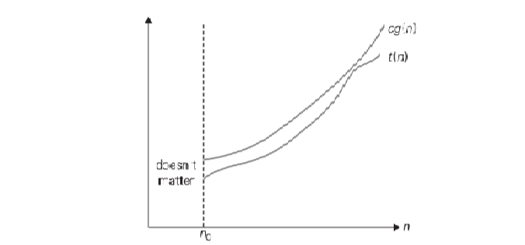

2.1 Big oh Notation
A function t(n) is said to be in O(g(n)), denoted t(n) ∈ O(g(n)), if t(n) is bounded above by some constant multiple of g(n) for all large n, i.e., if there exist some positive constant c and some non-negative integer $n_{0}$ such that -T(n) ≤ cg (n) for all n ≥ $n_{0}$

Slide 10
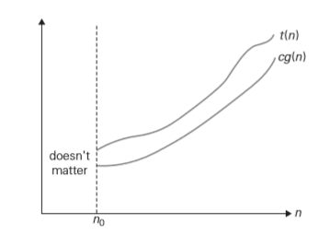

2.2 Big omega (Ω) Notation
It states that if a function t(n) is said to be in Ω(g(n)), denoted t(n) ∈ Ω(g(n)), if t(n) is bounded below by some positive constant multiple of (n) for all large n, i.e., if there exist some positive constants c and some non negative integer $n_{0}$ such that – $t\left(n\right)≥cg\left(n\right)$

Slide 11

2.3 Big theta (Θ) Notation
It states that is a function t(n) is said to be in Θ(g(n)), denoted t(n) ∈ Θ(g(n)), if t(n) is bounded both above and below by some positive constant multiples of g(n) for a large n, i.e., if there exist some positive constants and $c_{1}$and $c_{2}$ some non-negative integers $n_{0}$ such that - $c_{2}$g(n) ≤ t(n) ≤ $c_{1}$g(n) ; for all n ≥ $n_{0}$

Slide 12
3.0 Non recursive algorithms
General plan for analyzing the time efficiency of recursive algorithms
Decide on a parameter indicating an inputs’ size
Identify the basic operation
If number of times the basic operation is executed depends only on the input size.
  If not then the worst-case, best-case and average-case efficiencies have to be investigated separately.
Set up sum expressing the number of times the basic operation is executed
From the sum, find a closed-form formula for the count or establish its number of growth.

Slide 13
4.0 Recursive Algorithm
Decide on a parameter indicating an inputs’ size
Identify the basic operation
If number of times the basic operation is executed depends only on the input size.
  If not then the worst-case, best-case and average-case efficiencies have to be investigated separately.
4.Set up recurrence relation for the number of times the basic operation is performed
5.Solve the recurrence, or at least find the order of growth of its solution.

Slide 14
4.1 Recurrence relation
Recurrence relation is a function that defines its value at another point
  Namely n -1
Lets take for example the function for computing n! recursively
  F(n) = F(n - 1) * n for n > 0
The number of basic operations that need to be computed is
  M(n) = M(n - 1) + 1 for n > 0
  Where M(n – 1) is to compute F(n -1)
  And + 1 is to multiply F(n-1) by n
M(n) is called the recurrence relation.

Slide 15
4.1 Recurrence relation cont.
The goal is to find a solution to the recurrence relation formula M(n)
  To find an explicit formula for M(n) in terms of n only
To determine a solution a initial condition is needed.
The initial condition tells the value with which the sequence starts
  This value is obtained by inspecting the condition that makes the algorithm stop its recursive calls.
By inspecting the condition that makes the algorithm in the example before stop its recursive calls an initial condition of F(0) = 1

Slide 16
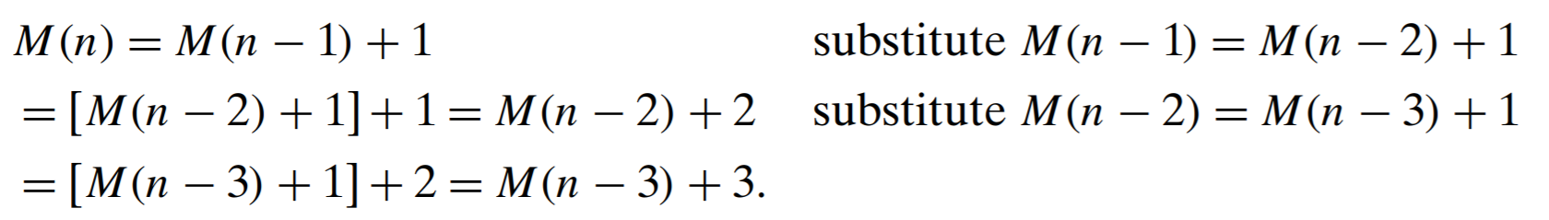
4.1 Recurrence relation cont.
Recurrence relation and initial condition is then
  M(n) = M(n − 1) + 1 for n > 0
  M(0) = 0.
The technique to solve the recurrence relation is called
  The method of backward substitution
When inspecting the first three lines a pattern can be extrapolated
  M(n) = M(n-i) * i

Slide 17
4.1 Recurrence relation cont.
Since the initial condition is specified as n = 0, i is substituted with n
The result of the backwards substitutions would be
  M(n) = M(n − 1) + 1 = ... = M(n − i) + i = ... = M(n − n) + n = n.
It is now clear that for the recursive function n! its order of growth is n

Slide 18
5.0 Fibonacci Number example
The Fibonacci sequence
  0, 1, 1, 2, 3, 5, 8, 13, 21, 34,...
Can be expressed as the recursion
  F (n) = F (n − 1) + F (n − 2) for n > 1
And two initial conditions
  F (0) = 0, F(1) = 1.
If backwards substitution does not give an easily discernable pattern

Slide 19
5.1 Fibonacci Numbers Theorem
Instead of the method of backward substitution the theorem that describes solutions to a homogeneous second-order linear recurrence with constant coefficients can be taken advantage of.
  ax(n) + bx(n − 1) + cx(n − 2) = 0
  Where a,b and c are fixed real numbers not equal to 0.
Applying this theorem to the recurrence with the initial conditions the formula can be obtained.
  Where φ = (1 + √ 5)/2 ≈ 1.61803 and φˆ = −1/φ ≈ −0.61803^6

Slide 20
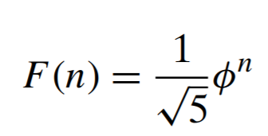
Fibonacci Numbers Theorem Cont.
Because φˆ gets infinitely small as n goes to infinity we can round F(n) to the nearest integer.

Slide 21

5.2 Algorithm for $n^{th}$Fibonacci number
The basic operation is addition A(n)
  A(n) is the number of additions in computing F(n)
We then get the recurrence
  A(n) = A(n − 1) + A(n − 2) + 1 for n > 1
  A(0) = 0, A(1) = 0
The following recurrences are the same except for the right hand side
  A(n) − A(n − 1) − A(n − 2) = 1
  F (n) − F (n − 1) − F (n − 2) = 0
These recurrences are called inhomogenous

Slide 22
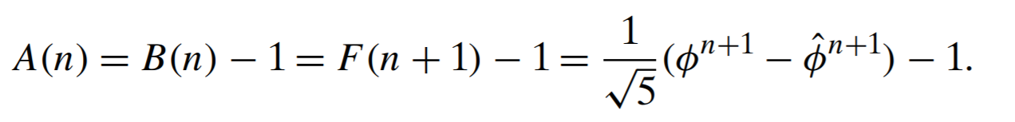

Algorithm for $n^{th}$Fibonacci number Contd.
The inhomogeneous recurrence can be rewritten as the homogeneous recurrence
  [A(n) + 1] − [A(n − 1) + 1] − [A(n − 2) + 1] = 0
And by substituting B(n) = A(n) + 1:
  B(n) − B(n − 1) − B(n − 2) = 0
  B(0) = 1, B(1) = 1
Here B(n) is the same as F(n + 1) and starts with two 1’s and thus runs one step ahead of F(n) and

Slide 23

Algorithm for $n^{th}$Fibonacci number Contd.
Hence
And if the size of n is measured by the number of bits in its binary representation, the efficiency gets even worse
Because of the nature of the recurrence, this poor efficiency was to be expected
  Two recursive calls with the sizes of smaller instances only slightly smaller than n
By iteratively computing the Fibonacci number the algorithm makes only n – 1 additions thus it is linear as a function of n.

Slide 24
5.3 Algorithm for n+1 Fibonacci number
Computes the nth Fibonacci number iteratively by using its definition
Input: A nonnegative integer n
Output: The nth Fibonacci number
F[0]←0; F[1]←1
for i ←2 to n do
F[i]←F[i − 1]+ F[i − 2]
return F[n]
This algorithm clearly makes n − 1 additions. Hence, it is linear as a function of n and “only” exponential as a function of the number of bits b in n’s binary representation.

Slide 25
6.0 Empirical Analysis of Algorithms
General plan for the Empirical Analysis of Algorithm Time Efficiency
  Understanding the purpose of the Experiment
  Deciding efficiency of metric M to measured along with the unit of measurement.
  Deciding upon the sample inputs
  Preparing program for experimenting implementation of algorithm.
  Generating samples of inputs.
  Executing algorithm of the sample
  Analyzing obtained data.

Slide 26

6.1 Algorithm for Empirical Analysis
//Generates a sequence of ‘n’ pseudorandom numbers according to the linear congruential method
//Input: A positive ‘n’ and positive integer parameter m, seed, a, b
//Output: A sequence $r_{1}{…r}_{n}$of n pseudorandom integers uniformly distributed among integers value between 0 and m-1
//Note: Pseudorandom numbers between 0 and 1 can be obtained by treating the integers generated as digits after the decimal point $r_{0} ←seed$
For i$←$1 to n do
$r_{i} ←\left( a ∗r_{i−1}+b\right)$Mod m

Slide 27
7.0 Algorithm Visualization
Algorithm visualization is a technique to convey information through images. The type of visualization techniques are:
  Static algorithm visualization – Display through still images
  Dynamic Algorithm visualization (Algorithm visualization) – display through movie-like presentations

